Slide 1
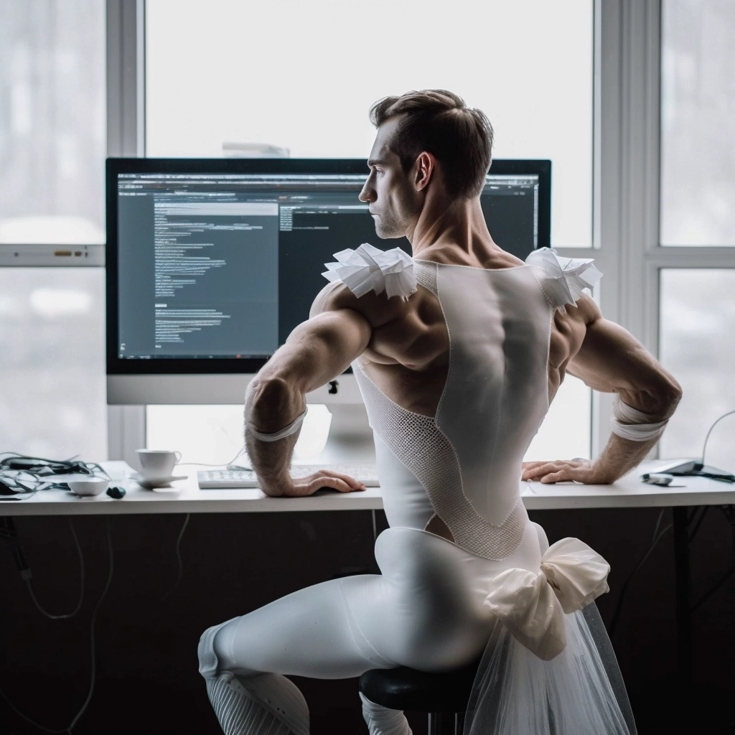
How to become a rockstar in a technical interview
Why it is worth signing up for dance lessons
Lukasz Fliegel

Slide 2


Why can I tell you about this?
I have been conducting technical interviews for many years
I have done over 100 TIs
There were ~70 of them in EPAM
I am a certified interviewer
I am a TI mentor

Slide 3
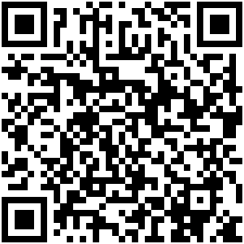
Presentation link
https://github.com/LukaszFliegel/TechnicalInterviewTalk

Slide 4
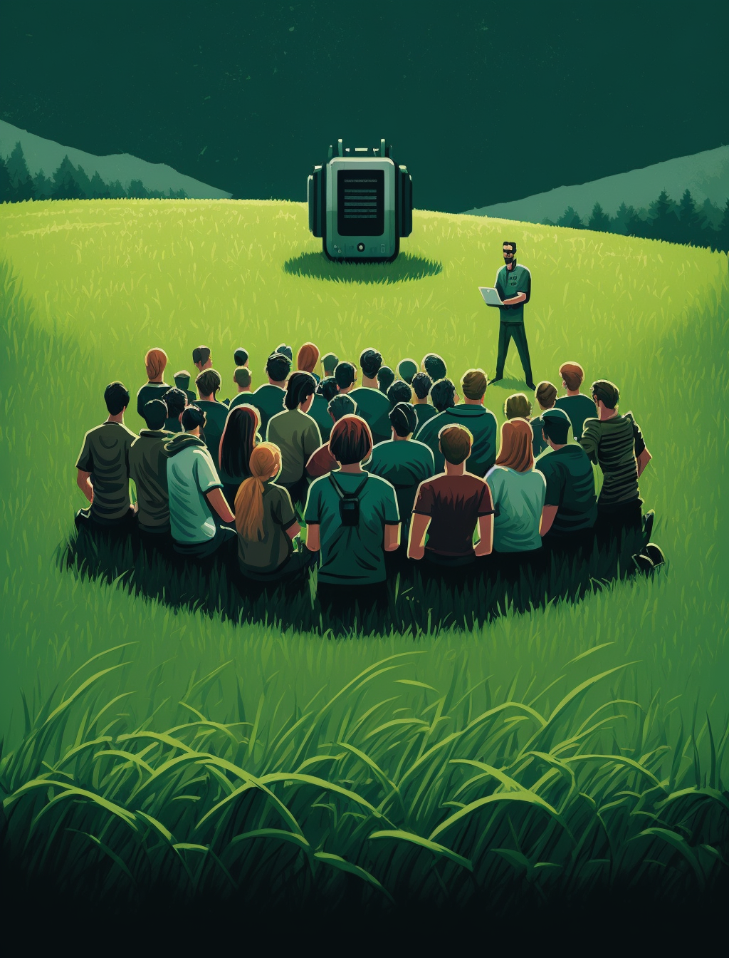
What will this presentation be about?
And what about it will not be
Notes:
https://wearecommunity.io/communities/epam-poland/articles/2395

Slide 5
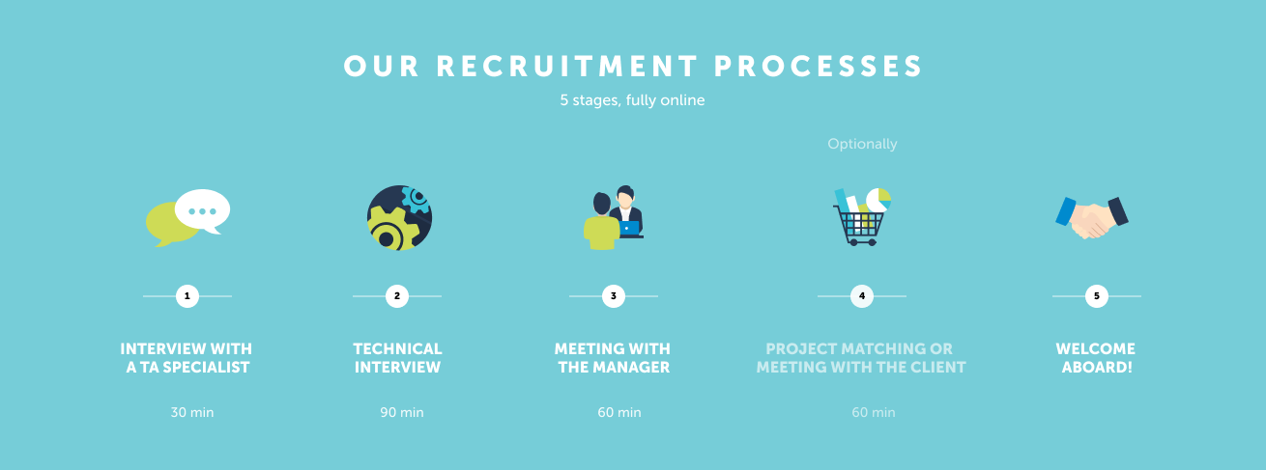
What does recruitment at EPAM look like?

Slide 6

Before we start
It depends on the recruiter
It depends on the culture
Each recruiter has their favorite topics that are important to him. There are people who like low-level questions, and those who ask about agile methodologies or architecture.
The "West" conducts the interview differently than the "East".

Slide 7

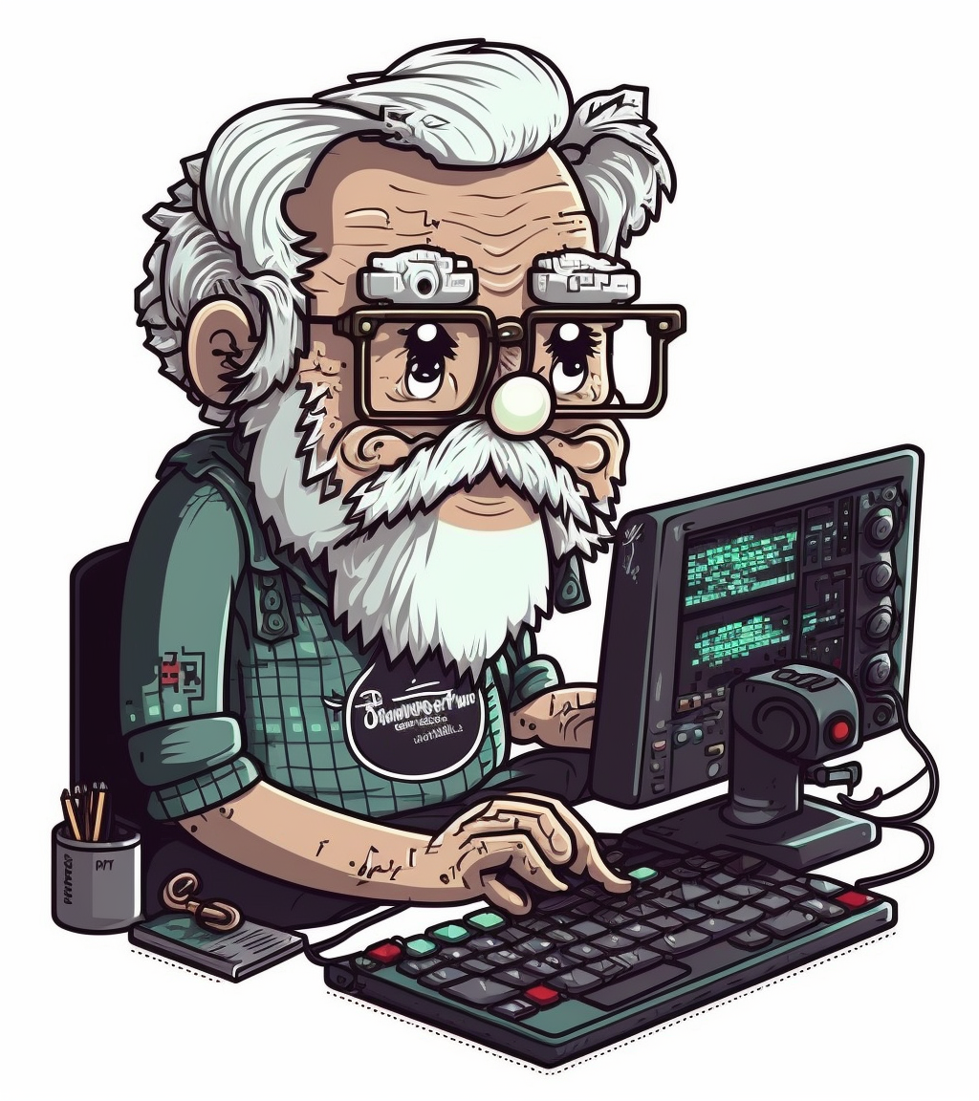
What I would like to hear someday
Long-term goals
Do clean shoes matter?
Where to buy a ballet costume?
EPAM Proprietary & Confidential.
7

Slide 8

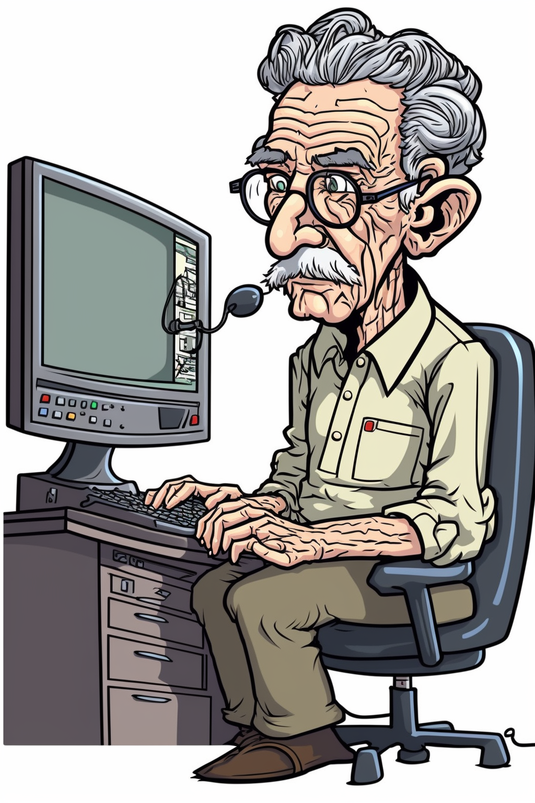
Proces rekrutacji
Co chciałbym usłyszeć kiedyś
Cele długoterminowe
Czyli co dział HR chce abym powiedział
Czyli dlaczego czyste buty mają znaczenie
Czyli gdzie kupić strój baletowy
EPAM Proprietary & Confidential.
8

Slide 9
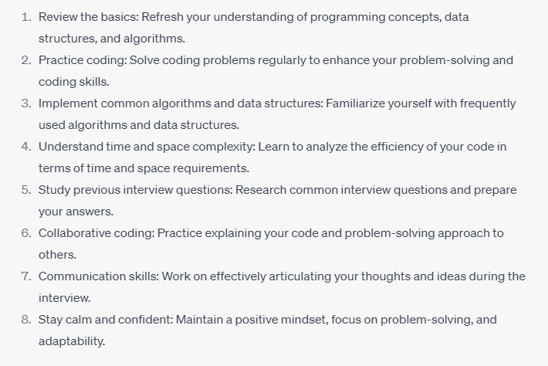
What can you hear from others (ChatGPT)?
Notes:
-ChatGPT także udziela rad doraźnych jak i długoterminowych

Slide 10
What would I like to hear?
When I started my adventure as a programmer

Slide 11
01
On TI, the questions are simple
Don't look for traps, the simplest answer is usually the right one

Slide 12
01
Tell the truth - or at least don't lie
Would you like to work with someone who doesn’t tell the truth?

Slide 13
02
If you don't know the answer
Say "I don't know"

Slide 14
04
There are two types of companies
Software houses and product companies

Slide 15
03
Treat it like a business meeting
In a technical interview, you offer your skills, the company offers contacts

Slide 16
04
Talk like with a friend
Avoid "uh, uh, I read about that, yeah..." and "... at the moment I can't remember it..."

Slide 17
05
Ask a smart question at the end
Why should I work for you?

Slide 18
What matters for the future?
What should I focus long term

Slide 19

01
Antifragility
Sign up for dance lessons

Slide 20
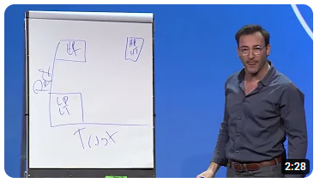
02
Trustworthiness
Simon Sinek - Trust vs Performance

Slide 21

03
Soft skills
Why I can’t work alone in the basement?

Slide 22

04
Books
Lots of books!

Slide 23
TODO: slajd z podsumowaniem punktów

Slide 24
Summary
- Tell the truth - or at least don't lie
- If you don't know the answer, say „I don’t know”
- Treat interview like a business meeting
- Talk like with a friend
- Ask a smart question at the end
- Antifragility
- Trustworthiness
- Soft skills
- Books

Slide 25
Summary
Tell the truth - or at least don't lie
02
If you don't know the answer, say „I don’t know”
03
Treat interview like a business meeting
04
Talk like with a friend
05
Ask a smart question at the end

Slide 26
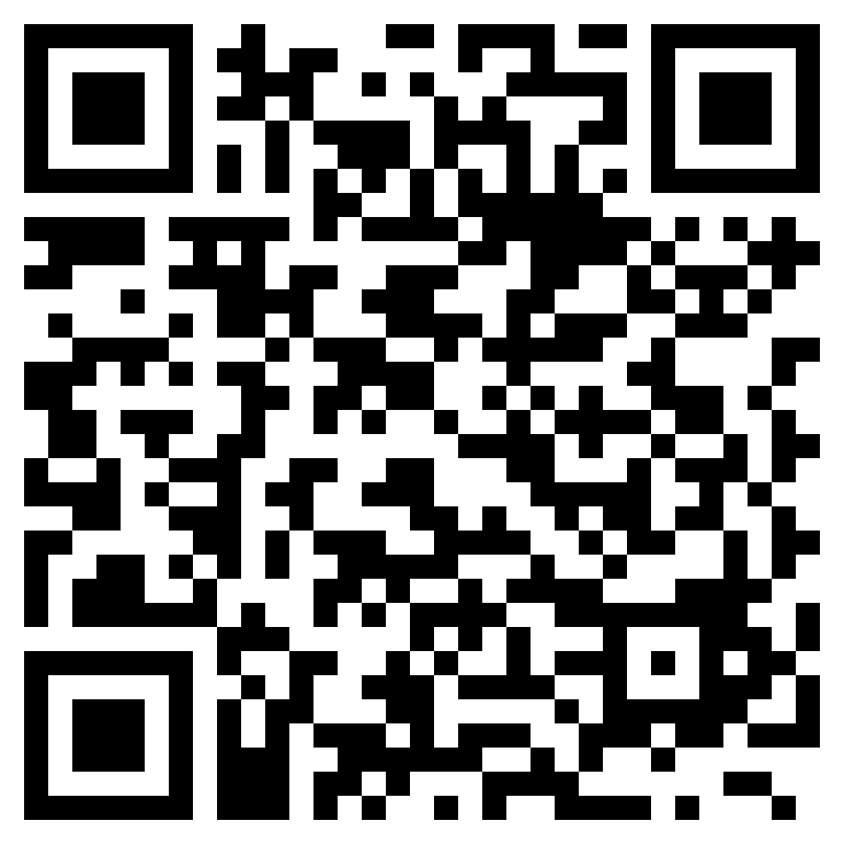
Interested?
https://training.epam.com/#!/TrainingList?lang=en&City=-56

Slide 27
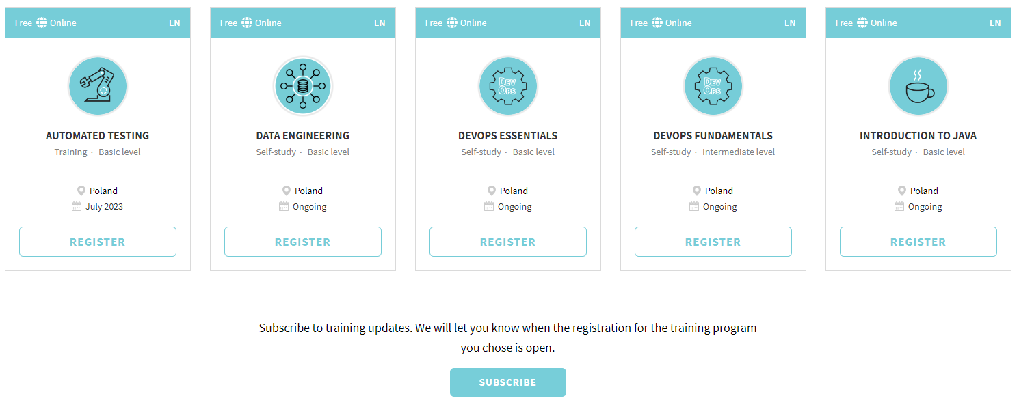
Interested?

Slide 28
Interested?
02
03
04
Data Enginering training EPAM | training.epam.com
05
Automated Testing Self-Paced Program | EPAM University | training.epam.com
06
Java Self-Paced Program | EPAM University | training.epam.com

Slide 29
Presentation link
https://github.com/LukaszFliegel/TechnicalInterviewTalk

Slide 30
Thank you!
Do not hesitate to contact me!
Łukasz Fliegel
Lead Software Engineer
lukasz_fliegel@epam.com

Slide 31
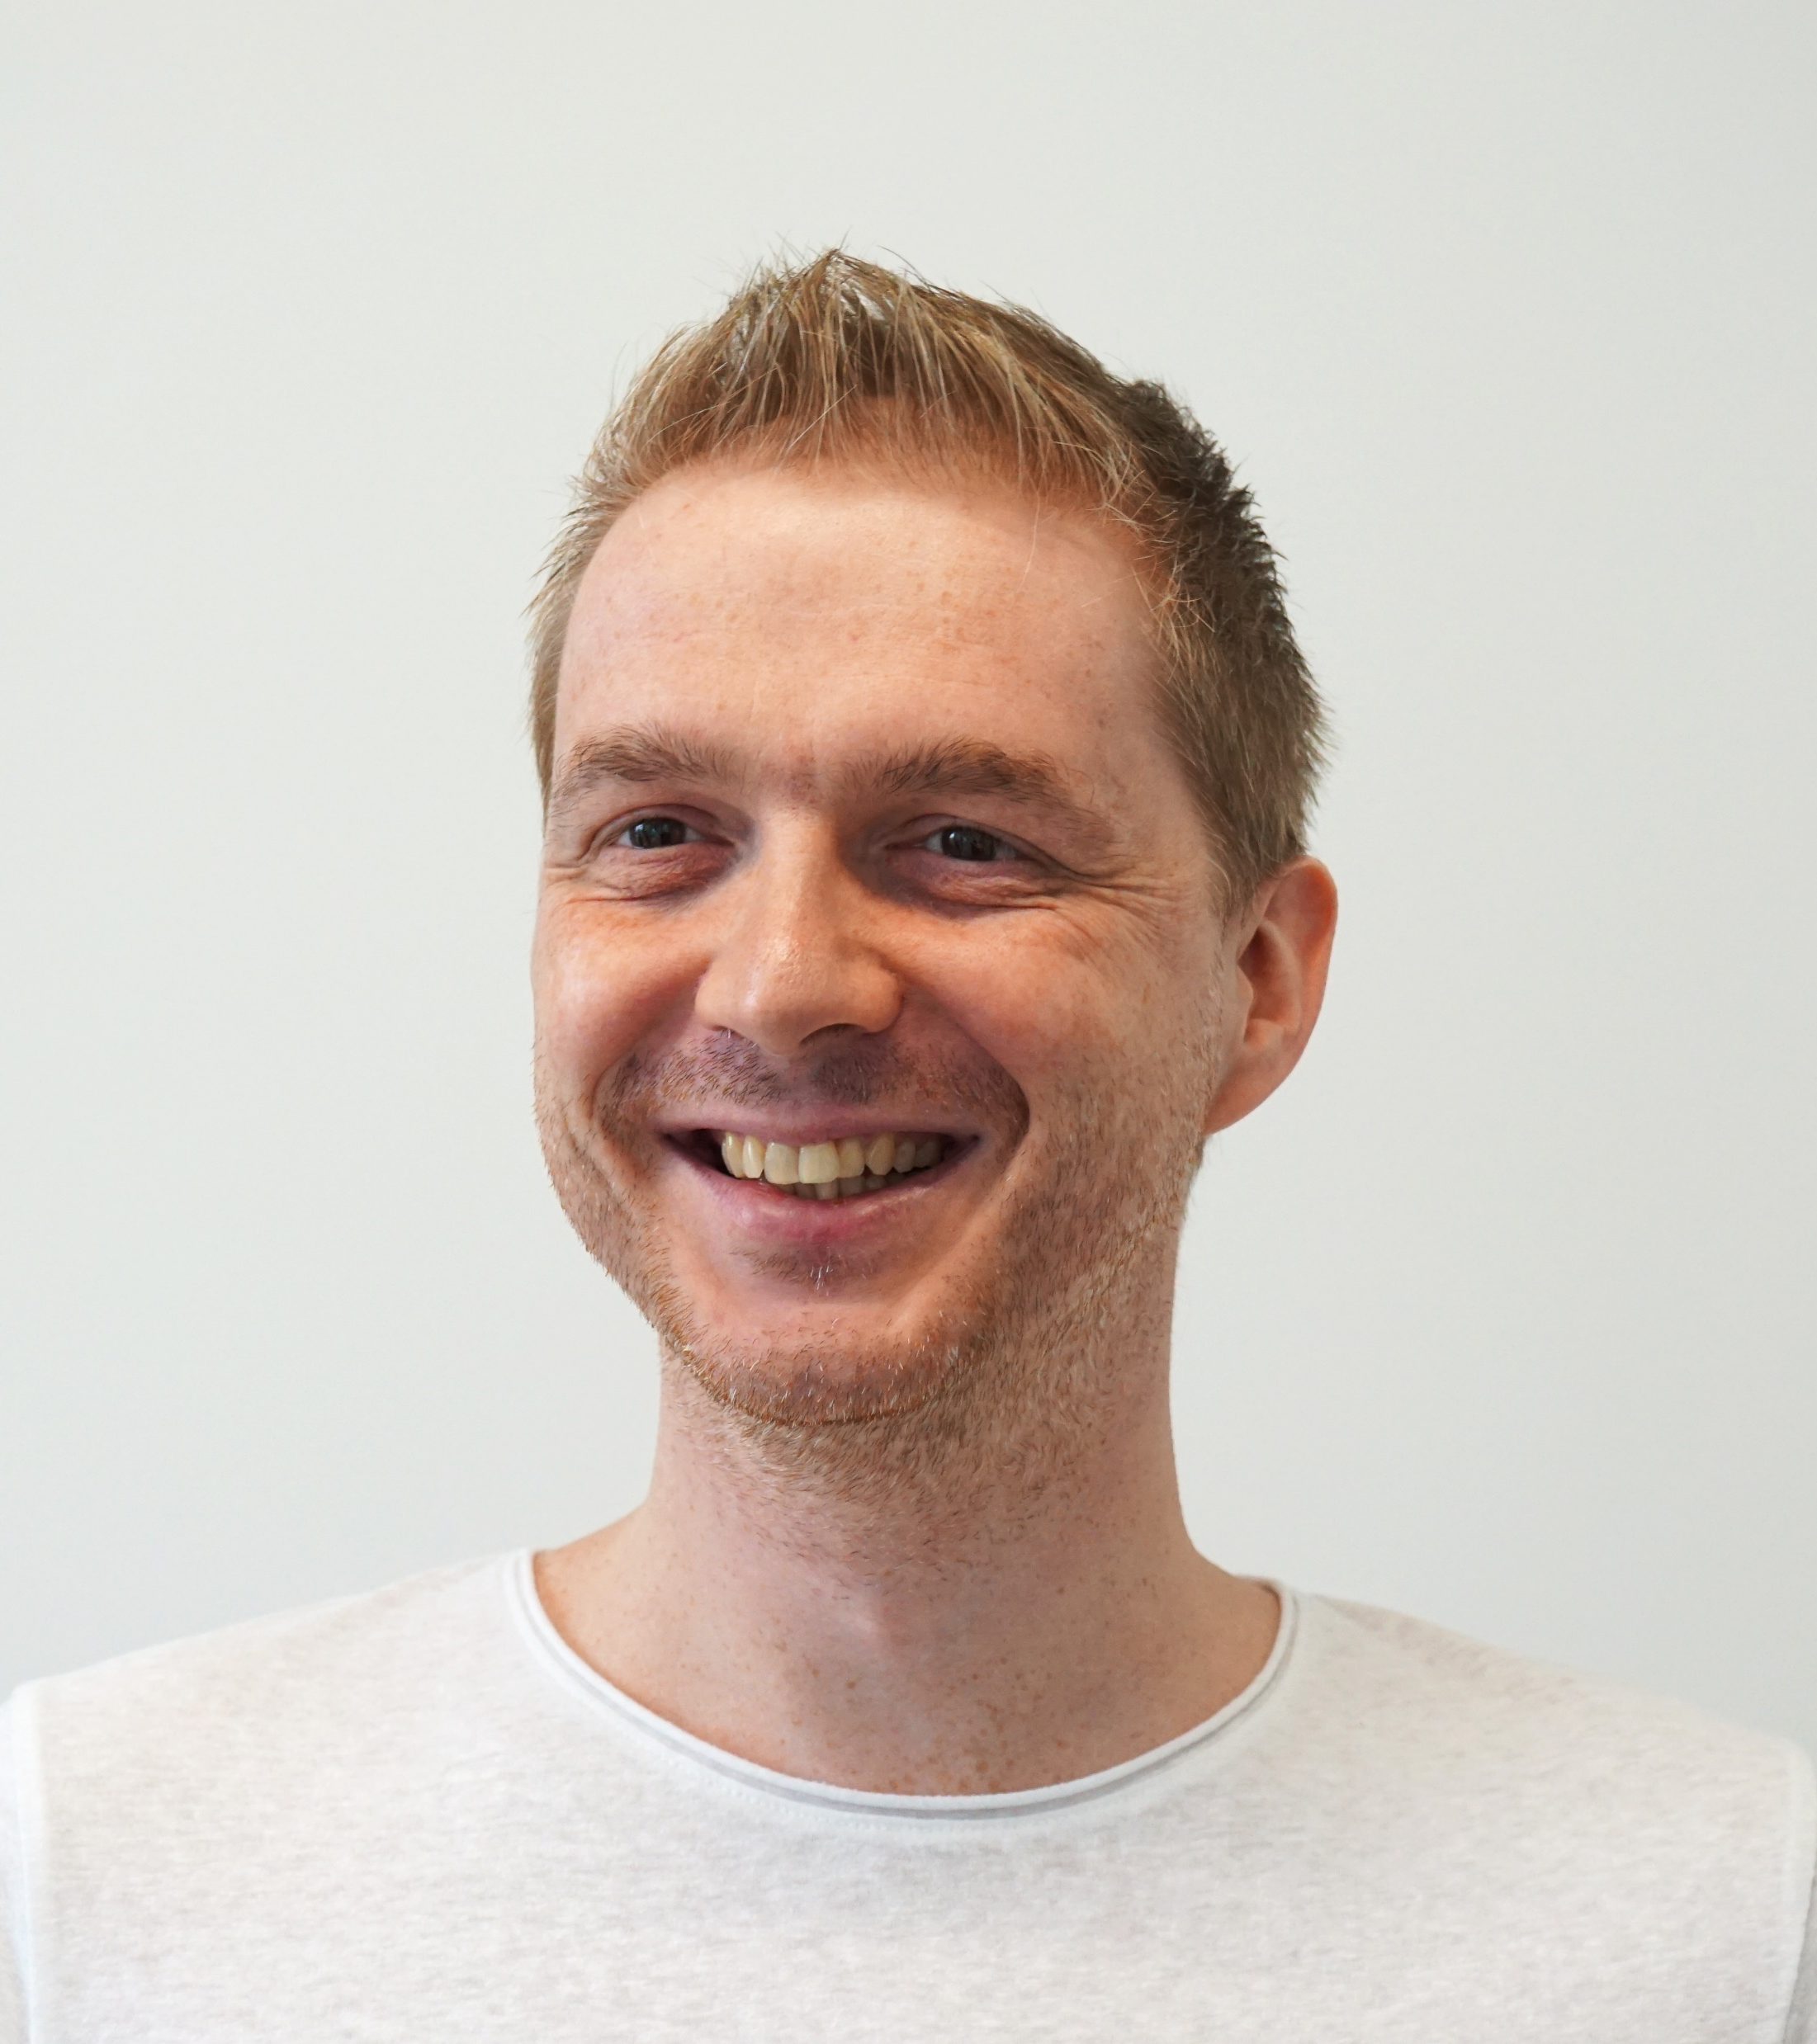
Thank you!
Do not hesitate to contact me!
Lukasz Fliegel
Lead Software Engineer
lukasz_fliegel@epam.com
Notes:
Wspomniec o platformie szkoleniowej gdzie sa techniczne i nietechniczne szkolenia
Zwyciezcę konkursu poprosić o zostanie na chacie, albo o napisanie do mnie

